Slide 1



FRADIS: Framework for Performance-aware Differentiated Innovative Services in 5G and Beyond Networks
Prof. Gabriel-Miro Muntean
Dr. Anderson Simiscuka
Dr. Abid Yaqoob

Slide 2

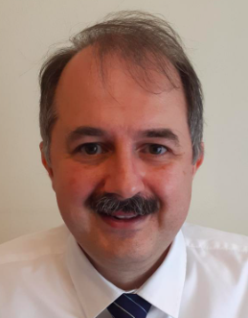

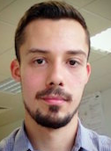
The FRADIS Team
Prof. Gabriel-Miro Muntean
Principal Investigator
Dr. Abid Yaqoob
Postdoctoral Researcher
Dr. Anderson Simiscuka
Postdoctoral Researcher

Slide 3

Outline
Research Motivation
Aims and Objectives
FRADIS System Architecture
Developed Solutions
Conclusion

Slide 4
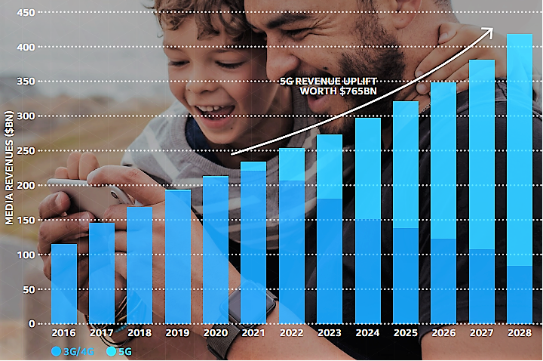
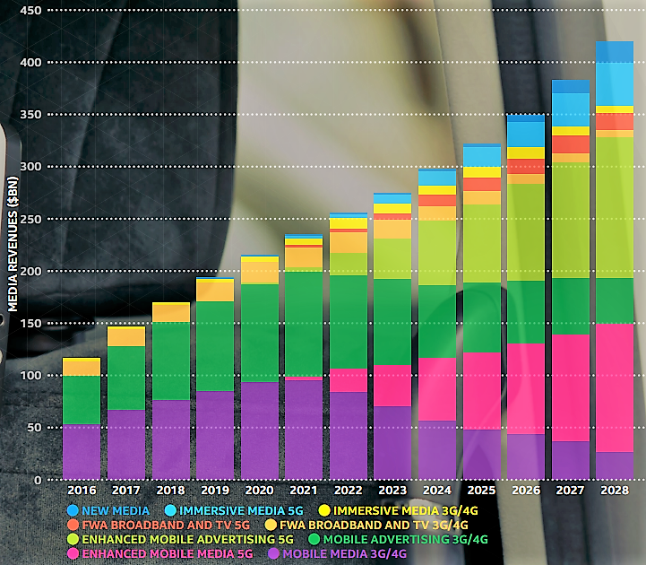
Research Motivation
Data Explosion and Diversification: Increasing explosion of multimedia data traffic. Annual mobile media revenues will reach $420bn by 2028
Network Technology and Provider Limitations: Current network infrastructure is limited to deal with the expected explosion of data and be able to support services with diverse characteristics.
Balancing Quality and Efficiency: Conflicting demands from users for high-quality services and the industry and society's needs for network performance and energy efficiency.
Source: HOW 5G WILL TRANSFORM THE BUSINESS OF MEDIA & ENTERTAINMENT

Slide 5

Aim and Objectives
FRADIS: FRAmework for performance-aware Differentiated Innovative Services.
  Supporting Differentiated Delivery of Services
  Heterogeneous Requirements
  Dynamic performance, energy consumption, and quality trade-off
  Optimise user and system performance
Supported Services:
  Rich Media Content
  Olfaction-enhanced Mulsemedia
  New and Immersive media 5G
  Enhanced Mobile Media 5G
  Diverse IoT and Sensor Data
Target Environment: 5G and Beyond Heterogeneous Network

Slide 6
FRADIS System Architecture
Immersive Mulsemedia Content
+
Applications Provisioning
Omnidirectional Mulsemedia Platform
Service
-
dependent Adaptive Delivery
Lower Network Layers (NetSli):
  Innovative Network Slicing (NetSli)-based solution
  Dynamic Traffic Control for Diverse Requirements
Transport Layer (µMPTCP):
  The utility-based MPTCP (µMPTCP) proposed in FRADIS extends MPTCP.
  It is a novel dynamic traffic characteristics-oriented performance, energy and quality-aware data transport protocol to improve the transmission efficiency and resource utilization.
  Consideration of Traffic Requirements, Network Conditions, and Energy Efficiency
Application Layer (IPDRL):
  Deep Reinforcement Learning-based Differentiated Adaptive Streaming Solution
  Delivery of Diverse Content Types
  Selection of Best Approach for Support
Interactive Support
Online Processing
3
Orientation
Tiles
DoF
+
6
DoF
Spatial Audio
Application Layer
Manager
Repackaging
Olfaction
Personalization
Streaming
Streaming
Regions
Quality
IPDRL ML
-
based Network Monitoring
QoS
-
Transport Layer
based Traffic Control
Performance
,
Quality
QoS Monitoring
,
µMPTCP
Energy monitor
Slice
-
based Dynamic Traffic Control
Slice Management
Resource Allocation
Traffic Optimization
Lower Network Layers
Olfaction Devices
QoE
Client Devices
Sensory
Audio and video
Feedback
Quality monitoring
Reward Modeling
Head and Eye
Tracking

Slide 7
Where We Are?
Innovative Adaptive Multimedia Delivery:
  FLAME
  FRED-ViQ
Collaborative Viewport Prediction:
  TOPVR
Novel Olfaction-Enhanced Omnidirectional VR Delivery:
  OmniScent
  Omni-CNN
Survey:
  A Comprehensive Survey on Artificial Intelligence Techniques for Improving the Quality of Rich Media Content Delivery in 5G Network Slicing Context

Slide 8
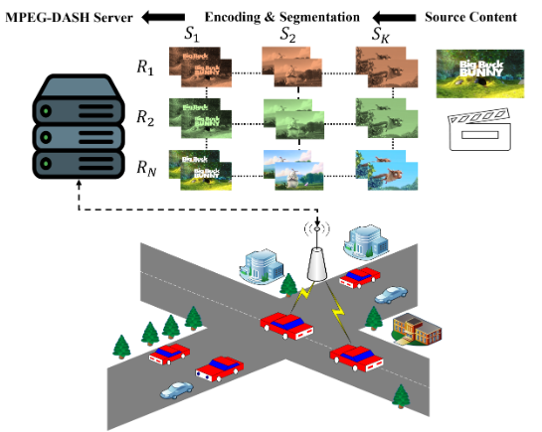
FLAME: Fuzzy Logic-based Streaming Solution
Salient Features
  Lightweight FLAME7 and FLAME5 fuzzy logic controllers
  Compact representation of state-action space
  Efficient modelling of Membership Functions
  Advanced Fuzzy Rules (49 and 25)
Modelling and Setup:
  Scikit-fuzzy
  PENSIEVE, BOLA, FESTIVE, BBA, ELASTIC
Performance Improvements:
Effective in enhancing user QoE
FLAME7 and FLAME5 solutions outperform state-of-the-art solutions by about 11.31% and 8.28%

Slide 9
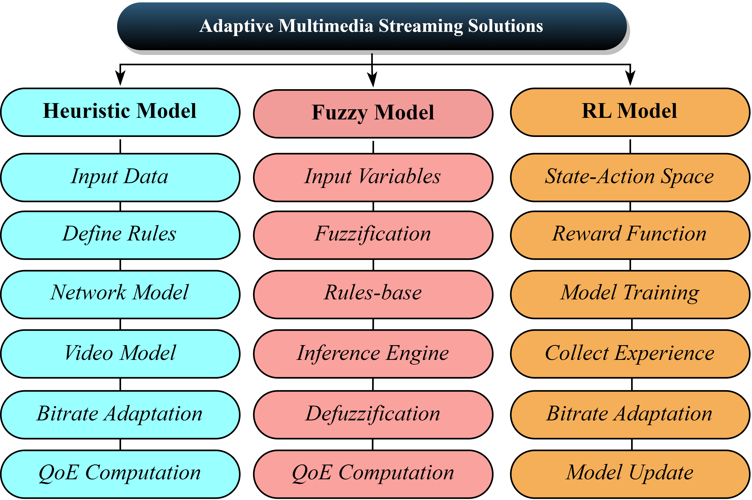
FRED-ViQ: Fuzzy Rainbow DRL-based Solution
Common Limitations
Sub-optimal convergence
Over- or under-bandwidth utilization
Sensitivity to input data
High dimensionality of state space
Inefficacious QoE modelling
Salient Features:
Combination of DDQN, NN, and PER
Sample Efficient Learning from experiences
Active engagement with the underlying environment
Balancing video quality and bandwidth utilization
Performance Improvements:
Linear QoE (23.10%)
Log QoE (23.97%)
HD QoE (33.42%)

Slide 10
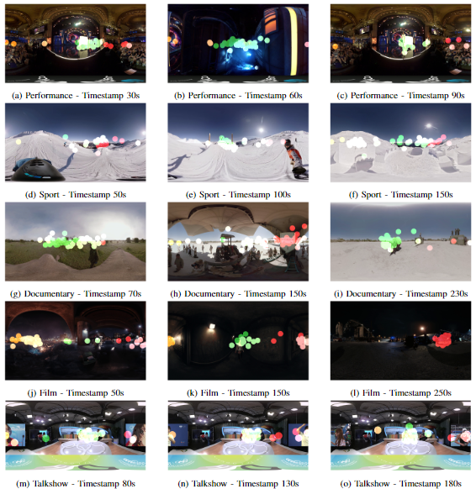
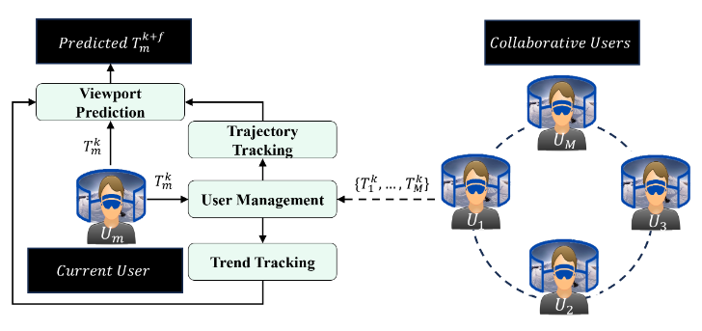
TOPVR: Trajectory Oriented VP Prediction
Performance Improvements:
31.12%-39.12% lower MAE
35.84%-44.17% lower MSE
24.89%-33.62% lower RMSE

Slide 11
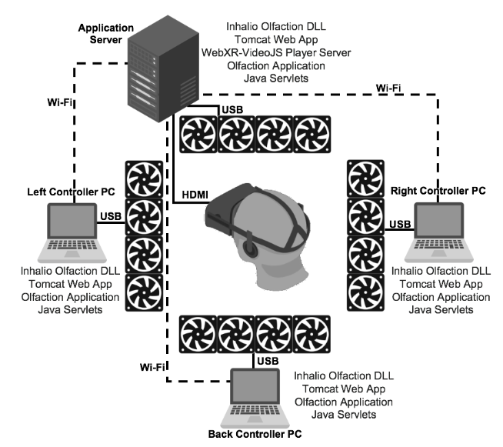
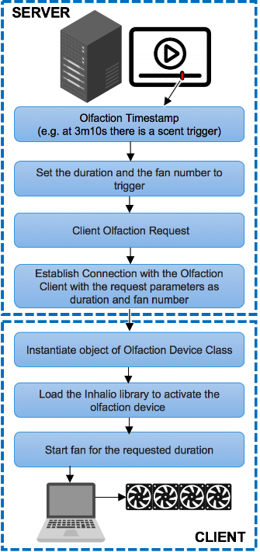
OmniScent: An Omnidirectional Olfaction-enhanced Virtual Reality 360° Video Delivery Solution for Increasing Viewer Quality of Experience
93% of participants agreed or strongly agreed that they were able to notice different smells in the videos and that scents were relatable to the content.
73% of participants agreed or strongly agreed that the smells helped them to look into the correct direction they were coming from in the video.
88% of participants agreed or strongly agreed that the smells helped in making the VR experience more immersive
95% of participants agreed or strongly agreed that scents helped in making the experience enjoyable

Slide 12
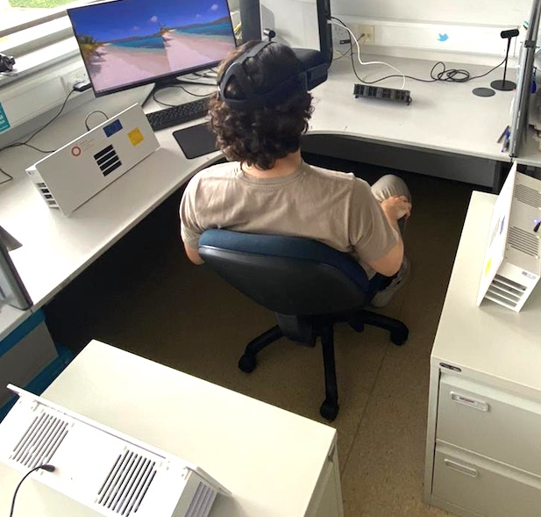
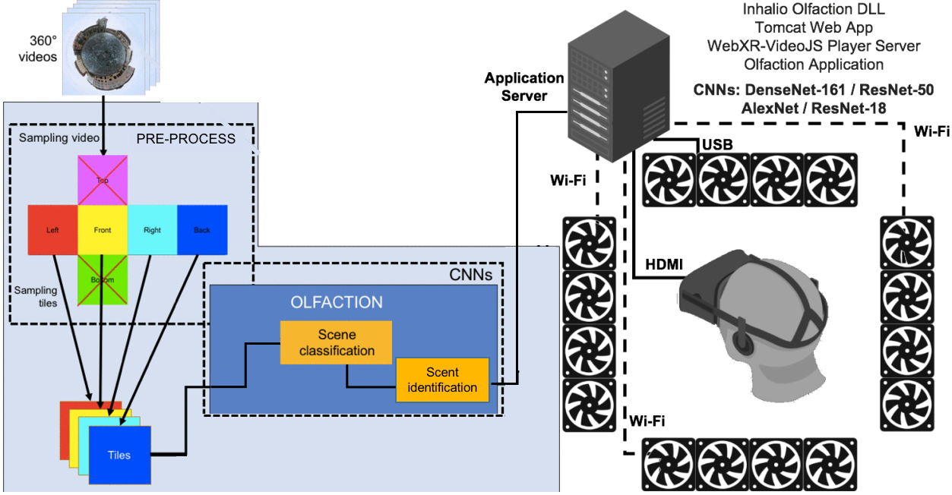
OmniScent-CNN: CNN-based 360° Scene Recognition for Automatic Generation of Omnidirectional Olfactive Effects
          Tests demonstrated an Olfaction Accuracy of up to 71.28%. 79% of participants agreed or strongly agreed that smells helped in making the VR experience more immersive and enjoyable.
          24 participants watched videos processed with different CNNs, and indicated ResNet-18 is the model with the best results in most of the questions answered.
          In order to automate the task of generating olfactory effects, Convolutional Neural Networks (CNNs) can be used to perform scene recognition.
          We tested DenseNet-161, ResNet-50, AlexNet and ResNet-18.

Slide 13
Conclusions
FRADIS is an integrated solution to support the provision of innovative services with highly diverse requirements in the context of 5G and beyond networks.
FRADIS will design an innovative Network Slicing-based solution for dynamic control to support the distribution of traffic with diverse requirements.
At the transport layer, FRADIS will include a novel dynamic traffic characteristics-oriented multi-path data transport protocol to improve transmission efficiency and resource utilization.
At the application layer FRADIS will include machine learning-based adaptive solutions for differentiated delivery of diverse content types, including emergency, control, and rich media content.

