Slide 1
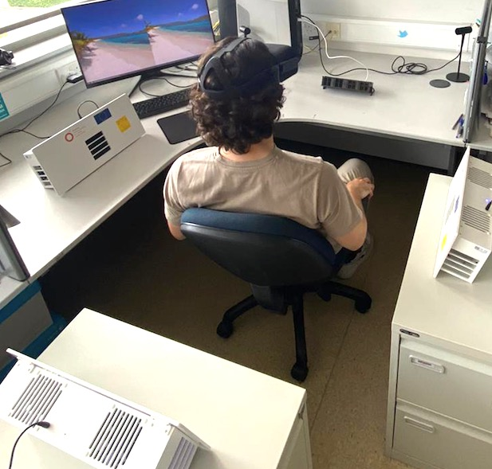
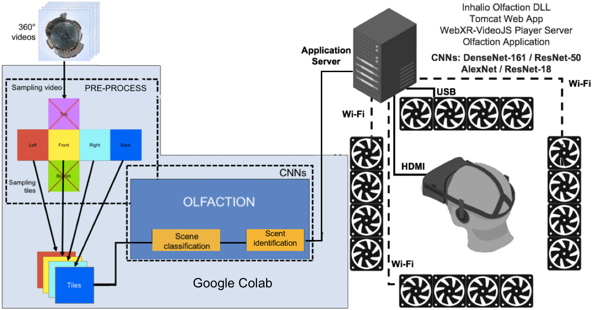
CNN-based 360° Scene Recognition for Automatic Generation of Omnidirectional Olfactive Effects
Anderson Augusto Simiscuka, Theo Plantefol, Abid Yaqoob and Gabriel-Miro Muntean
Contact: anderson.simiscuka@insight-centre.org, theo.plantefol2@mail.dcu.ie,
abid.yaqoob@dcu.ie, gabriel.muntean@dcu.ie
Introduction
Scents are connected to the brain memory function and can be used in various areas, including marketing, product design and entertainment.
Olfactory stimuli, combined with visual and audio cues, enable the creation of more realistic experiences in immersive environments.
In 360° videos, omnidirectional scents can be used as a cue to help users to look into important areas of the videos.
In order to automate the task of generating olfactory effects, Convolutional Neural Networks (CNNs) can be used to perform scene recognition.
Four CNNs were compared on the cloud-based platform Google Colab.
The CNNs detect the scent, tile and time of effect occurrence.
Each tile of the 360° video can trigger scents independently, on the respective scent dispenser.
The application server controls the scent dispensers via USB or WiFi. It also sends videos to the Oculus Rift.
System Architecture
Testing and Results
Multiple olfaction devices are placed around a user, releasing scents in the same direction with the triggering scene in the 360º video. Videos are watched with an Oculus Rift VR headset.
Tests demonstrated an Olfaction Accuracy of up to 71.28%. A number of participants evaluated the solution, which was perceived positively and helped to improve Quality of Experience (QoE): 79% of participants agreed or strongly agreed that smells helped in making the VR experience more immersive and enjoyable.
24 participants watched videos processed with different CNNs, and indicated ResNet-18 is the model with the
best results in most questions.

